Slide 1
Data Marsh Mallows
Real Time Network Voice Call Quality Data

Slide 2
Agenda
Overview of Dataset
EDA
Model - Random Forest n KNN
Evaluation
Conclusion

Slide 3



Dataset Overview | Network Voice Call Quality
Definition
Provide E2E visibility of FTTx network. This network visibility will also be an enabler for improving assurance LNI
Objectives
Network Performance Monitoring : Comparison of Expected Performance verse Actual Performance
Enables Network Operators to compare their performance in comparison and invest accordingly to improve their marketshare. This would enable a competitive and fair marketplace across India
Measurements
Prediction of Voice Call Quality Category given Operator, Network Type, Lat , Long etc.

Slide 4
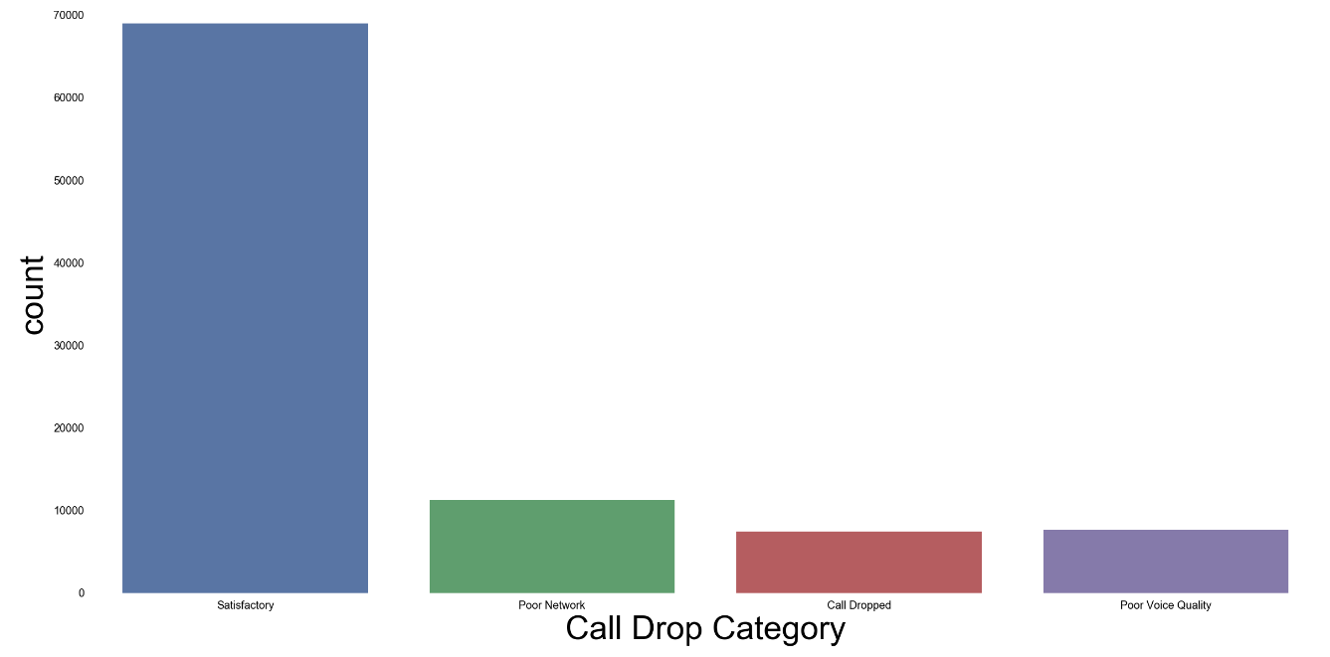
Overall call drop category

Slide 5
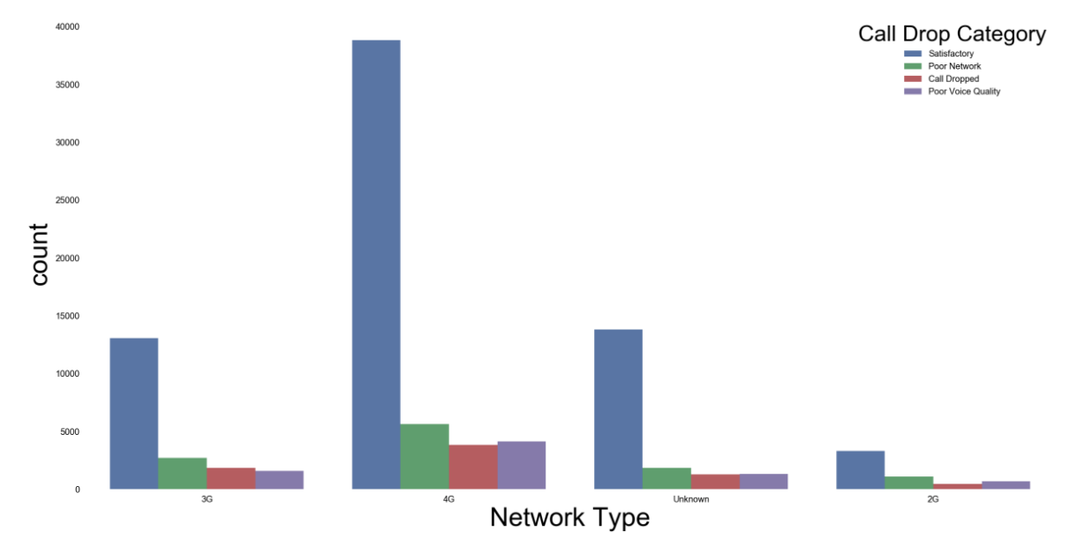
Call drop category (rating) vs network type

Slide 6
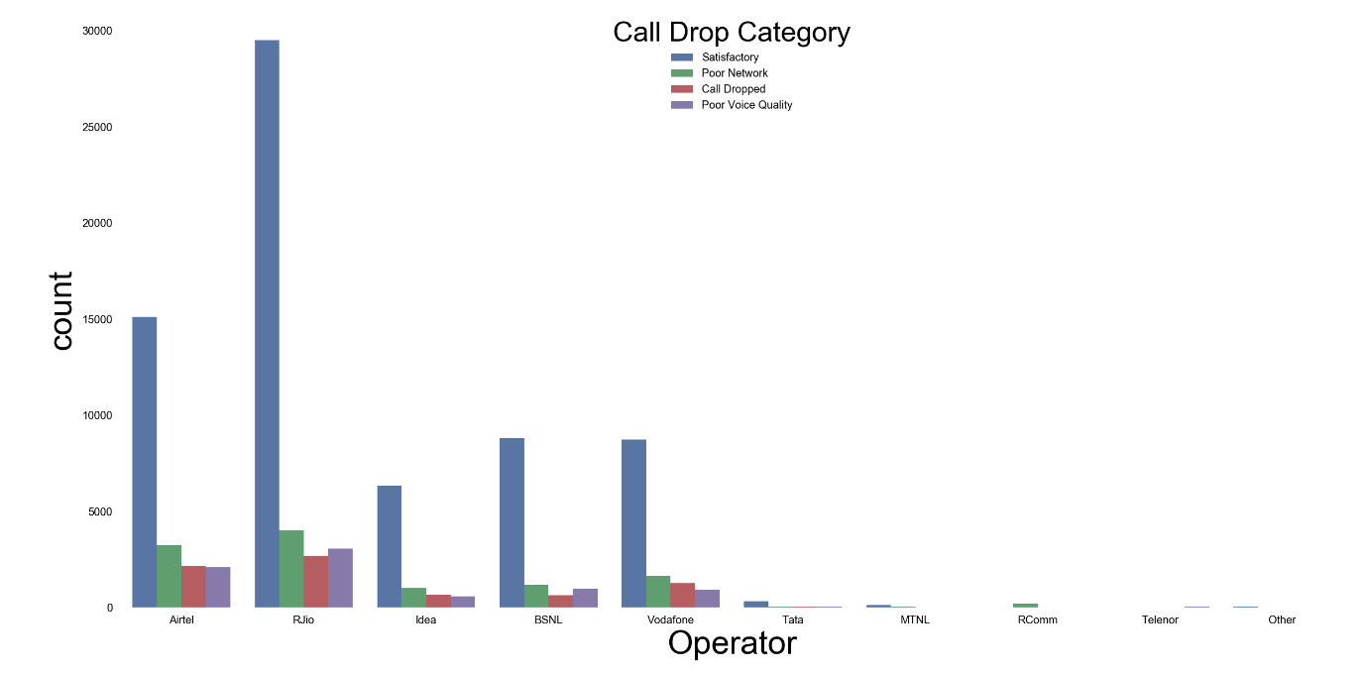
Count of Call-drop-category for each service provider (overall)

Slide 7
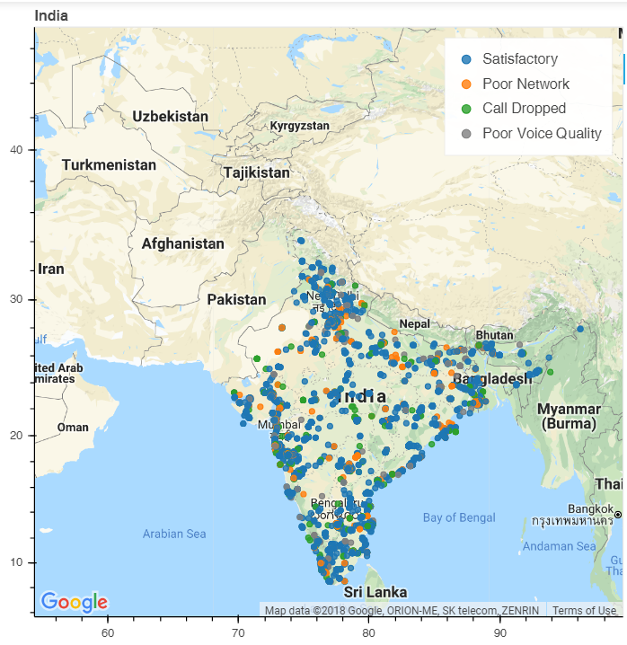

Slide 9
Model | Random Forest Tree
Input feed to the machine learning model
Predictors/features (Operator, Indoor_Outdoor_Travelling,Network Type,State Name,)
Target column
Measurements
Signed off for FTTX
KNN
Model
Objectives Definition
Provide E2E visibility of FTTx network. This network visibility will also be an enabler for improving and migration work required for Capacity Management will only implemented in Phase 3 of LNI

Slide 10
Model | KNN
Business Objectives
Assurance
DSV automation
Measurements
Signed off for FTTX
EDA
Objectives Definition
Provide E2E visibility of FTTx network. This network visibility will also be an enabler for improving and migration work required for Capacity Management will only implemented in Phase 3 of LNI

Slide 11
Evaluation And Conclusion

Slide 12
Thank you
.

